Slide 1
ROOT LOCUS - INTRO

Slide 2
ROOT LOCUS - INTRO
ROOT LOCUS is a graphical representation in s-domain
It is symmetrical about the real axis.
…….Because the open loop poles and zeros exist in the s-domain having the values either as real or as complex conjugate pairs.

Slide 3

Rules for Construction of Root Locus
Rule 1 − Locate the open loop poles and zeros in the ‘s’ plane.
Rule 2 − Find the number of root locus branches.
The root locus branches start at the open loop poles and end at open loop zeros.
So, the number of root locus branches N is equal to the number of finite open loop poles P or the number of finite open loop zeros Z, whichever is greater.

Slide 4

Rules for Construction of Root Locus
Rule 3 − Identify and draw the real axis root locus branches.
Rule 4 − Find the centroid and the angle of asymptotes.
The formula for the angle of asymptotes θ is
Where, q = 0,1,2,....,(P−Z)−1

Slide 5
Rules for Construction of Root Locus
Rule 6 − Find Break-away and Break-in points.
Write K in terms of s from the characteristic equation
1+G(s)H(s)= 0.
Differentiate K with respect to s and make it equal to zero. Substitute these values of s in the above equation.
The values of s for which the K value is positive are the break points.

Slide 6
Rule 7 − Find the angle of departure and the angle of arrival.
The Angle of departure and the angle of arrival can be calculated at complex conjugate open loop poles and complex conjugate open loop zeros respectively.

Slide 7
Step 8: Crossing point on the imaginary axis
Separate the imaginary terms and real terms by substituting s= jω, and equate the equations to zero. From which to find the value of K. The respective ω value is the crossing point on the imaginary axis & K value is the stability limit of the system.

Slide 8

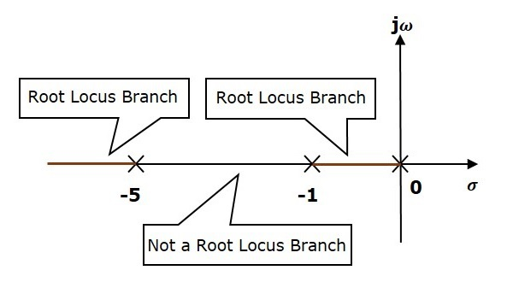

Slide 9

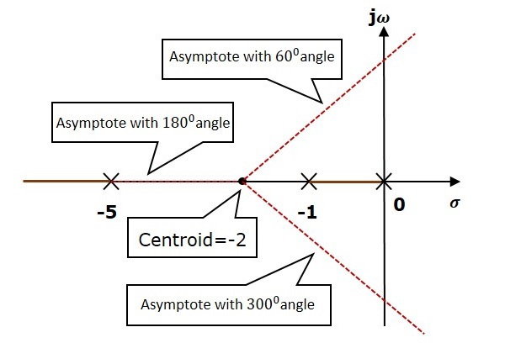
Centroid = ∑(real part of finite OL poles) – ∑(real part of finite OL zeros)]/(N-P] = (0-1-5-0)/3 = -2, angle of asymptotes = 180(2q+1)/(N-P)

Slide 10


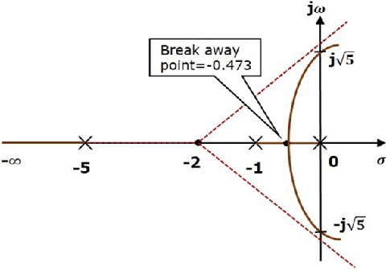
Char.eqn :
= -( s³ + 6s² + 5s)
dK/ds = -(3s² + 12s +5)
[ we get it as s=−0.473, -3.52 ]
With dK/ds = 0; find its roots, for which value of s, K value is +ve. i.e. is the breakaway point.
There will be one break-away point
on the real axis root locus branch
b/n the poles s=−1and s=0.

Slide 11
S³+ 6s² + 5s +K = 0
S→ jω
Hence -j ω³ – 6 ω² + 5 ω + K = 0
Seperating the real & imag. Seperately.
ω value is ±√ 5

